Slide 1
세상 모든 자연과 통하다
GLOBAL ECO THE SAEM
Gold Snail Swirl Wrinkle Plumper

Slide 2
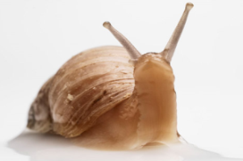
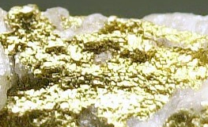
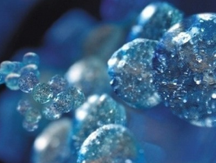
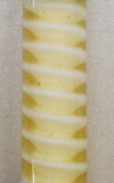
Profile of Gold Snail Swirl Wrinkle Plumper
Product Name | Gold Snail Swirl Wrinkle Plumper
Concept
TARGET | Mid 30s and over whose looking for wrinkle-care treatment Women who wants to get cosmetic injection for wrinkles.
Price | Korean Retail Selling Price (KRSP) : ₩50,000 / 15ml
Powerful Wrinkle-Plumping spot treatment
Innovative 3D Swirl technology and vital anti-aging ingredients are used to diminish visible signs of winkles
No more injection !
70% Snail Mucin for Intense nourishment and Firming
24 K Gold for Rejuvenation, Circulation stimulus.
Hyaluronic acid for plumping fine lines and wrinkles.
Ingredients & Features
How To Use | Dispense a small amount and spread onto wrinkled area.
3D Swirl Designing Technology: allows the separate preservation of cream-based ingredients and gel-based ingredients.
Creamy layer: Deep wrinkle treatment ( Snail mucin, Ceramide, copper /penta peptide
Gel layer: Fine line treatment + Moisture supply (Snail mucin, Gold, Hyaluronic acid)
70 % Snail Mucin filtrate: promotes collagen synthesis, outstanding ability of hydration supply & preservation.
24K Nano Gold : Stimulates circulation, helping to eliminate toxins in the skin.
Hyaluronic acid: Naturally occurring moisture molecule. Amazing ability to retain moisture, fills in wrinkles and lines with moisture.
Niacinamide: Efficacy-proven ingredient (by Korean food & Drug administration ) as a whitening agent. Inhibits delivery of melanosome (pigmentation causing cells).
Adenosine: Wrinkle-care Efficacy-proven ingredient. Great cell renewal helper.

